Slide 1
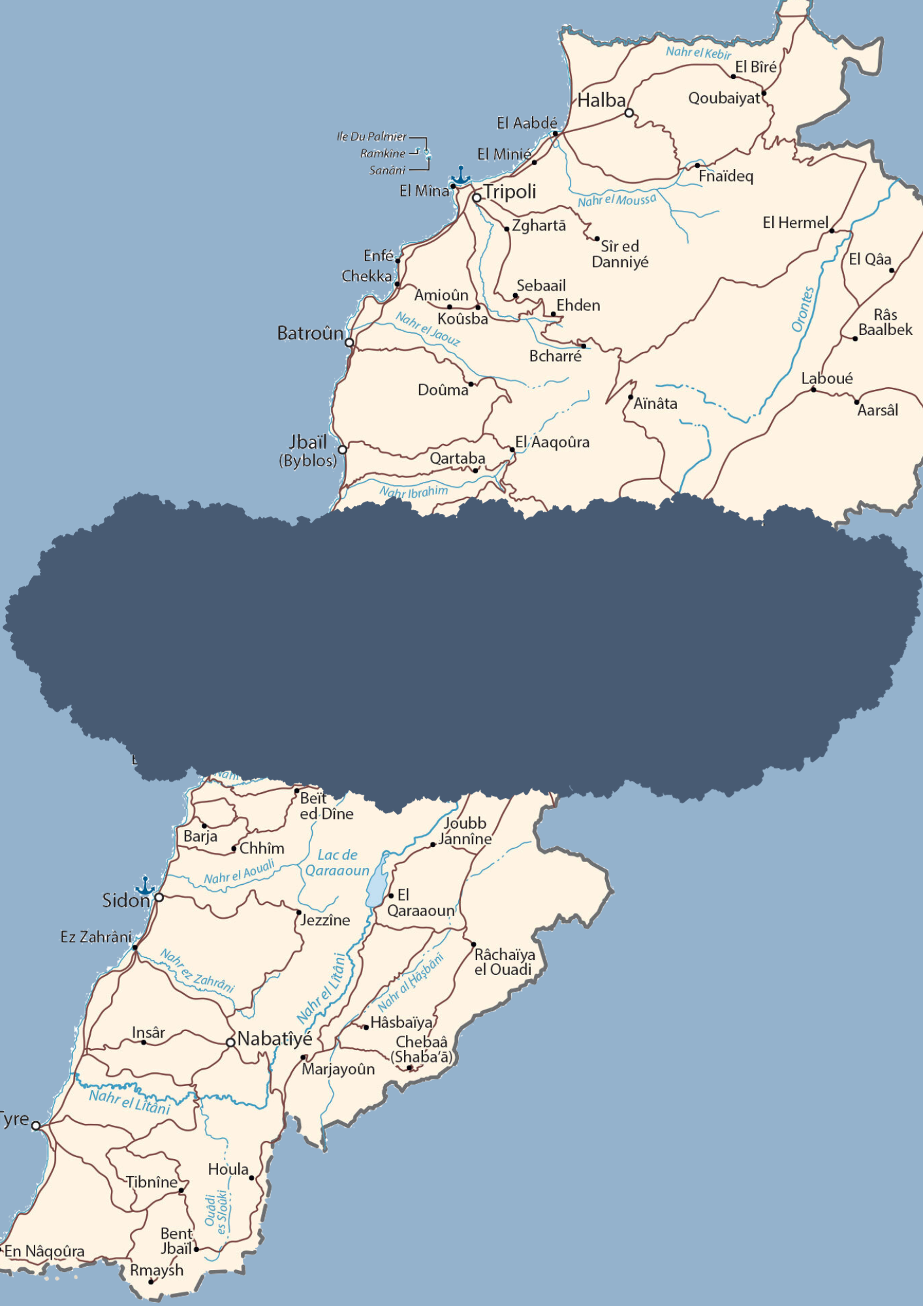

HUMAN RIGHTS DEVELOPMENTS IN A WEEK
9 June - 15 June 2025
SOURCE: LEBANON MAP

Slide 2



Human Rights are inherent to all human beings, regardless of the nationality, place of residence, sex, national or ethnic origin, color, religion, language or any other status without discrimination. These rights are all universal, inalienable, interrelated, interdependent and indivisible.
The articles shared in this brief are the liability of their respective news outlets and do not reflect the views of CLDH.
LEBANON
Israeli forces shoot car in Wazzani
Israeli gunfire targeted a pickup truck on the Ain Arab, Wazzani road from the Hamames hill on Monday, June 9. The driver was able to escape and was not harmed.
Simultaneously, an Israeli airstrike targeted another car on the Wadi al-Nimriya, Zifta road with two missiles.
Israel conducts bulldozing and combing operations in the South
Israeli forces carried out a bulldozing operation between Markaba and Houla, and conducted a combing operation with heavy machine guns from the occupied Hamames hill towards Marjeyoun plain on Monday, June 9. Two grenades were also dropped in Ras al-Naqoura and Ramya and no injuries were recorded.
The Lebanese army also located two Israeli drones in the towns of Houla - Marjeyoun and Beit Lif - Bint Jbeil.
Two citizens killed and another injured in Israeli airstrike on Shebaa
An Israeli airstrike attacked Jenaam, Shebaa and resulted in two deaths and one injury on Tuesday, June 10, according to the Public Health Emergency Operations Center.
Simultaneously, Israeli forces crossed borders and entered Lebanese territory in the Krom al-Marah in Mays Al Jabal, two vehicles and a bulldozer
Lebanese army reopens Houla road after clash between citizens and UNIFIL patrol
A dispute erupted between citizens and a UNIFIL patrol that was conducting search operations in Fawwar, located between Deir Qanoun al-Nahr and Halousieh in Tyre district on Tuesday, June 10. The physical confrontation was caused by the interception of the patrol by the citizens, who were protesting against the absence of a Lebanese Army escort.
After an intervention from the army, the situation was solved and the UNIFIL patrol was prompted to leave the area.
Monday
9 June 2025
Tuesday
10 June 2025

Slide 3
Lebanese Army arrests citizens transporting shells and ammunition
Statement issued by the Army Command - Directorate of Orientation issued on Wednesday, June 11:
On June 10, 2025, as a result of a precise security operation, the Intelligence Directorate in the Chtaura-Zahle area arrested citizens (M.N.) and (H.J.) while transporting a large quantity of shells, rockets, and ammunition in their own vehicle. The aforementioned directorate also raided their homes in the town of Tamnin, Baalbek, and seized a large quantity of weapons, ammunition, and drugs, in addition to counterfeit money.
Israeli soldiers cross blue line in Blida
More than 50 Israeli soldiers crossed the Blue Line in the Bir Shuaib area in Blida, accompanied by two bulldozers in the early morning hours of Wednesday, June 11. The soldiers conducted a bulldozing operation after the Lebanese army removed a previous breach from the same area.
One citizen killed and three injured in Israeli airstrike on Beit Leef
An Israeli airstrike fired a missile at the courtyard of a house in Beit Lif, Bint Jbeil district, which led to the death of one person and the injury of three others.
Israeli airstrikes over border areas
Three Israeli airstrikes targeted Tabna and a series of raids were attacking the area between Al-Rayhan and Sajd on Thursday, June 12. Two airstrikes also hit Zghrin in Jabal Al-Rayhan and another airstrike was on the outskirts of Al-Aishiyeh, and three mortar shells attacked the Wadi Al-Asafir area in Al-Khayam.
Simultaneously, the Lebanese Army removed earthen barriers and reopened the Shebaa-Hasbaya roads that Israeli forces had closed.
One citizen killed in Nabatieh and another injured in Deir Siryan
An Israeli drone targeted a motorcycle with a guided missile on the Nabatieh al-Fawqa road and killed one citizen on Thursday, June 12. Another airstrike on a motorcycle in Deir Siryan resulted in one injury.
Israeli interceptor missiles exploded in border cities
Three interceptor missiles exploded over the Matla border area on Friday, June 13, and two others fell on the Hasbani River and over Abel al-Saqi.
Wednesday
11 June 2025
Thursday
13 June 2025
Friday
14 June 2025

Slide 4
Saturday and Sunday
14 and 15 June
2025
Seven injured in airstrike on Beit Leef
An Israeli airstrike targeted Beit Lif with two rockets and injured seven citizens on Saturday, June 14. Another citizen survived a soundbomb thrown in his vicinity in Kfarkila.
Simultaneously, flash bombs were fired over Aita al-Shaab and a soundbomb was thrown in Hawra between Kfarkila and Deir Mimas.
Ministry of Agriculture follows environmental violation in Koura
Statement issued by the Army Command - Directorate of Orientation issued on Wednesday, June 11:
The Ministry of Agriculture detected a serious environmental violation in the Bchemzine area of ​​Koura District. This violation involved the encroachment and cutting down of ancient sapwood trees without any legal license. [...]
The inspection revealed the extent of the extensive damage to the forest cover, as tannin trees are a rare and long-lived species that play a pivotal role in maintaining ecological balance and biodiversity in Lebanon's mountainous regions.
Israeli forces conduct combing operations and drop mortar shells
Israeli forces conducted a combing operation in Ras al-Naqoura area with heavy weapons, and opened fire toward Wadi Qatmoun, east of Rmeish on Sunday, June 15. Forces also targeted the outskirts of Aita al-Shaab with mortar shells.
Simultaneously, the Lebanese Army captured an Israeli drone that fell on the outskirts of Mays al-Jabal in Bint Jbeil.

Slide 5
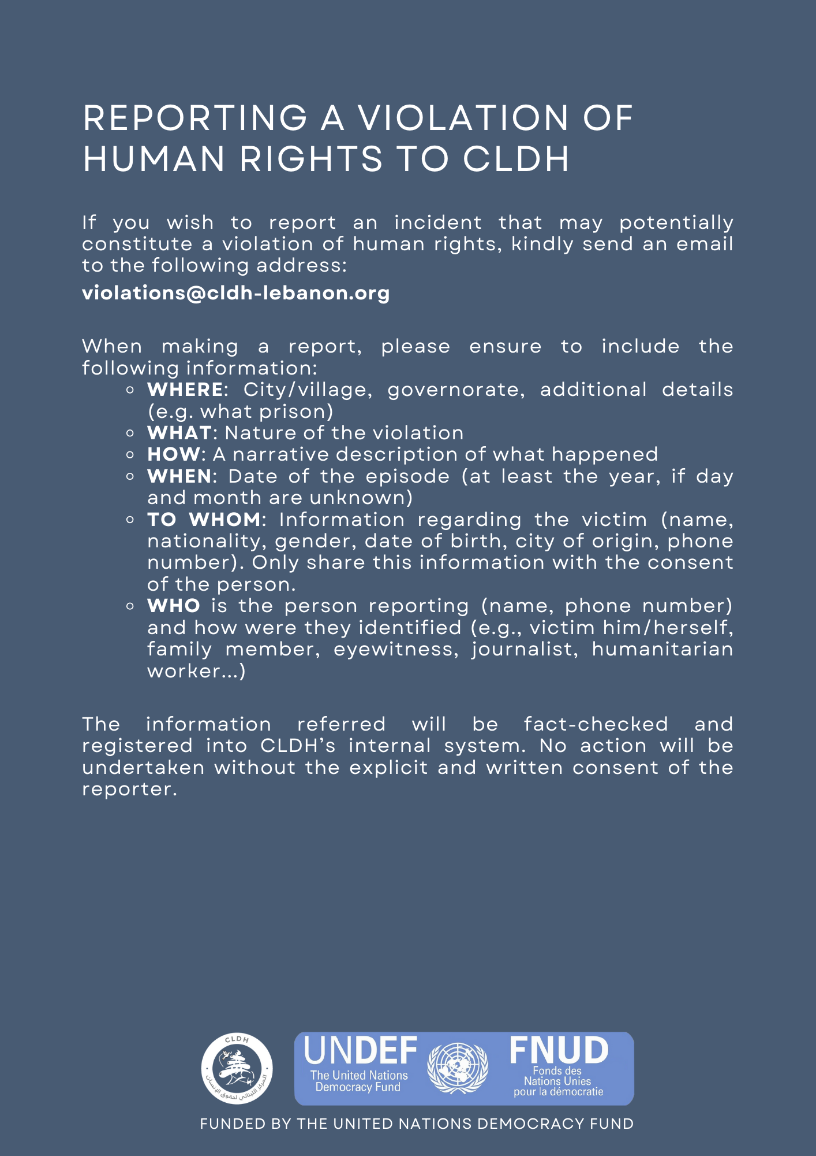

REPORTING A VIOLATION OF HUMAN RIGHTS TO CLDH
If you wish to report an incident that may potentially constitute a violation of human rights, kindly send an email to the following address: violations@cldh-lebanon.org
You can also report an incident anonymously through our website.
When making a report, please ensure to include the following information:
  WHERE: City/village, governorate, additional details (e.g. what prison)
  WHAT: Nature of the violation
  HOW: A narrative description of what happened
  WHEN: Date of the episode (at least the year, if day and month are unknown)
  TO WHOM: Information regarding the victim (name, nationality, gender, date of birth, city of origin, phone number). Only share this information with the consent of the person.
  WHO is the person reporting (name, phone number) and how were they identified (e.g., victim him/herself, family member, eyewitness, journalist, humanitarian worker...)
The information referred will remain completely private. It will be fact-checked and registered into CLDH’s internal system. No action will be undertaken without the explicit and written consent of the reporter.
FUNDED BY THE UNITED NATIONS DEMOCRACY FUND

